Slide 1
Design Patterns
Elements of Reusable Object-Oriented Software
Patrick Schmidt
Microsoft Certified Trainer

Slide 2
Schedule
Day 1
Introduction
Block 1
Block 2
Day 2
Block 3
Block 4
Day 3
Block 5
Block 6

Slide 3
Object Orientation
Simplified model of real-world problems
Encapsulation
Inheritance
Polymorphism
Interaction

Slide 4
SOLID
Single-responsibility principle: "There should never be more than one reason for a class to change.“ In other words, every class should have only one responsibility.
Open–closed principle: "Software entities ... should be open for extension, but closed for modification."
Liskov substitution principle: "Functions that use pointers or references to base classes must be able to use objects of derived classes without knowing it.“
Interface segregation principle: "Clients should not be forced to depend upon interfaces that they do not use."
Dependency inversion principle: "Depend upon abstractions, [not] concretions."

Slide 5
The Book Design Patterns
Creational Patterns
Defer object creation to derived classes or to another object
Structural Patterns
Patterns to compose classes or objects
Behavioral Patterns
Derivation and composition to achieve intricate flow of control or task handling

Slide 6
Pattern structure
Name
Intent
Motivation
Applicability
Structure
Consequences.

Slide 7
Block 1
Iterator
Observer
Singleton
Visitor
Exercise 1

Slide 8
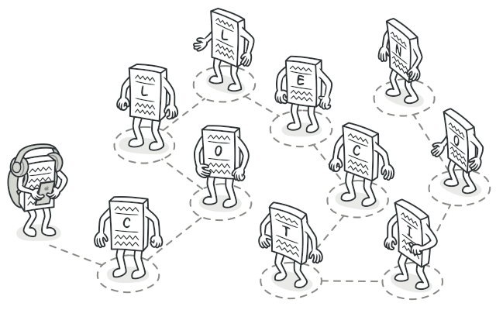
Iterator
@https://refactoring.guru

Slide 9
Iterator
Type: Behavioral Pattern
Intent: Provide a way to access the elements of an aggregate object sequentially without exposing its underlying representation.

Slide 10
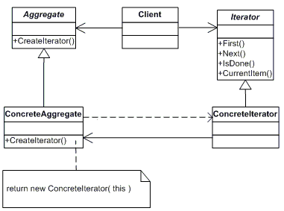
Iterator

Slide 11
Iterator
Applications
foreach statement in C#

Slide 12
Iterator
Pros
Single Responsibility Principle.
You can clean up the client code and the collections by extracting bulky traversal algorithms into separate classes.
Open/Closed Principle.
You can implement new types of collections and iterators and pass them to existing code without breaking anything.
You can iterate over the same collection in parallel because each iterator object contains its own iteration state.

Slide 13
Iterator
Cons
Applying the pattern can be an overkill if your app only works with simple collections.
Using an iterator may be less efficient than going through elements of some specialized collections directly.

Slide 14
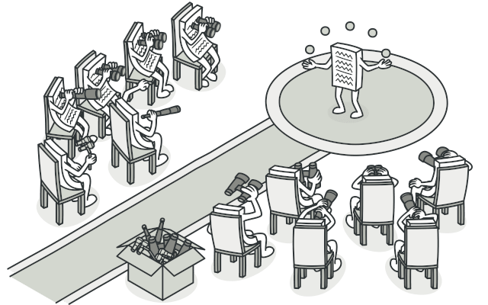
Observer
@https://refactoring.guru

Slide 15
Observer
Type: Behavioral Pattern
Intent: Define a one-to-many dependency between objects so that when one object changes, all its dependents are notified and updated automatically.

Slide 16
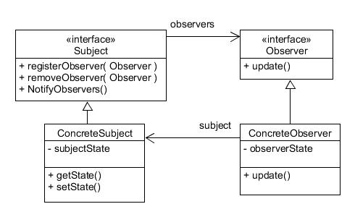
Observer

Slide 17
Observer
Applications
Change Detection mechanisms
Model View Controller (Views are observers)
Delegates (Multi cast)
RxJs

Slide 18
Observer
Pros
Open/Closed Principle.
You can introduce new subscriber classes without having to change the publisher’s code.
You can establish relations between objects at runtime.
Cons
Subscribers are notified in random order

Slide 19
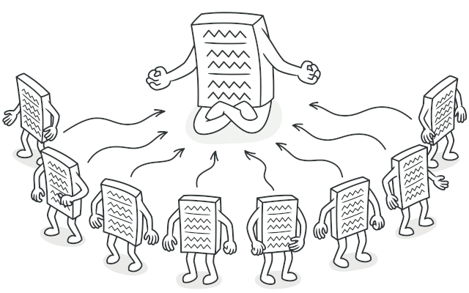
Singleton
@https://refactoring.guru

Slide 20
Singleton
Type: Creational Pattern
Intent: Ensure a class only has one instance and provide a global point of access to it.

Slide 21
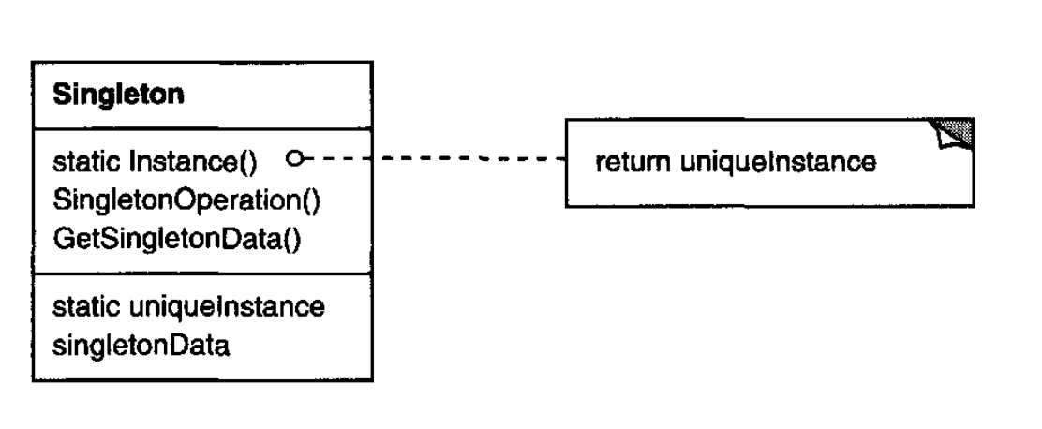
Singleton

Slide 22
Singleton
Applications
Single access to…

Slide 23
Singleton
Pros
You can be sure that a class has only a single instance.
You gain a global access point to that instance.
The singleton object is initialized only when it’s requested for the first time.
Cons
Violates the Single Responsibility Principle.
The pattern solves two problems at the time (creation and operations).
The pattern requires special treatment in a multithreaded environment.

Slide 24
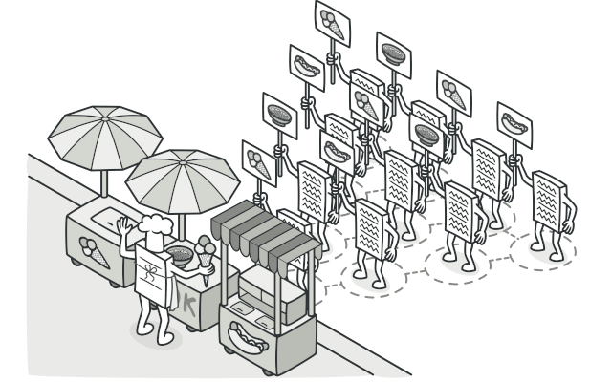
Visitor
@https://refactoring.guru

Slide 25
Visitor
Type: Behavioral Pattern
Intent: Represents an operation to be performed on the elements of an object structure. Visitor lets you define a new operation without changing the classes of the elements on which it operates.

Slide 26
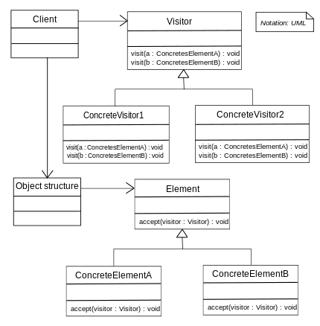
Visitor

Slide 27
Visitor
Applications
Bill of Material can have visitor to calculate the total price, a visitor to determine the time it takes to create, a visitor to calculate the total delivery time.
Drawing. Shapes that have a draw visitor, storage Visitor, total surface calculator Visitor etc.
Evaluating Expression trees

Slide 28
Visitor
Pros
Separation of Concerns:
Visitor Pattern that creates cleanness of responsibilities by structuring the algorithm or operation independent of the object that this operation acts on.
Open/Closed Principle:
By disconnecting the algorithms from the elements inside the object structure, the Visitor Method conforms to the open/closed principle.
Extensibility:
The visitor Method allows applying iterators and adding new operations to the current object, making it more flexible.
Modularity:
The Visitor Pattern encourages modular design in that it isolates and keeps the related behavior(s) in a separate visitor implementation.

Slide 29
Visitor
Cons
Increased Complexity:
Taking a visitor method approach requires us to determine multiple interfaces and classes, including visitor interfaces, concrete visitor implementations, and element interfaces.
Violation of Encapsulation:
In certain cases, the Visitor Pattern can be the source of encapsulation violation. As a visitor usually contains an internal state of elements that visitors need to operate on, these details should be private and, therefore, should not be exposed.
Runtime Overhead:
Calling the accept method for each time introduces additional time which is being used for relaying the visit method to the visitor which is an object and the element which is an object as well.

Slide 30
Exercise 1

Slide 31
Block 2
Chain of Responsibility
Mediator
Proxy
Prototype
Exercise 2

Slide 32
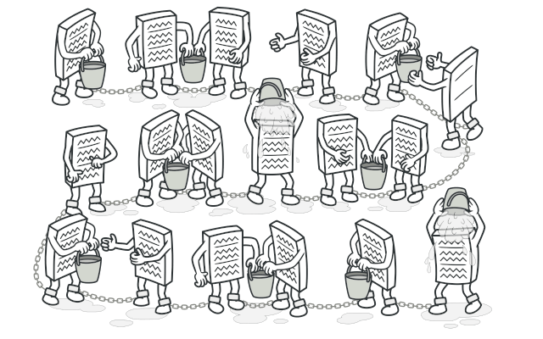
Chain of Responsibility
@https://refactoring.guru

Slide 33
Chain of Responsibility
Type: Behavioral Pattern
Intent: Avoid coupling the sender of a request to its receiver by giving more than one object a chance to handle the request. Chain the receiving objects and pass the request along the chain until an object handles it.

Slide 34
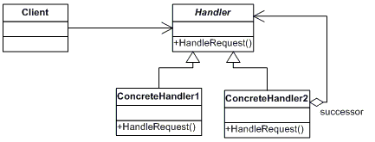
Chain of Responsibility

Slide 35
Chain of Responsibility
Applications
Help Files
Support systems
Events
Exceptions

Slide 36
Chain of Responsibility
Pros
The pattern makes enables sending a request to a series of possible recipients without having to worry about which object will handle it in the end.
New handlers can be easily added, or existing ones can be modified without affecting the client code. This promotes flexibility and extensibility within the system.
The sequence and order of handling requests can be changed dynamically during runtime, which allows adjustment of the processing logic as per the requirements.
It simplifies the interaction between the sender and receiver objects, as the sender does not need to know about the processing logic.

Slide 37
Chain of Responsibility
Cons
The chain should be implemented correctly otherwise there is a chance that some requests might not get handled at all, which leads to unexpected behavior in the application.
The request will go through several handlers in the chain if it is lengthy and complicated, which could cause performance overhead.
The fact that the chain has several handlers can make debugging more difficult.
It may become more difficult to manage and maintain the chain of responsibility if the chain is dynamically modified at runtime.

Slide 38
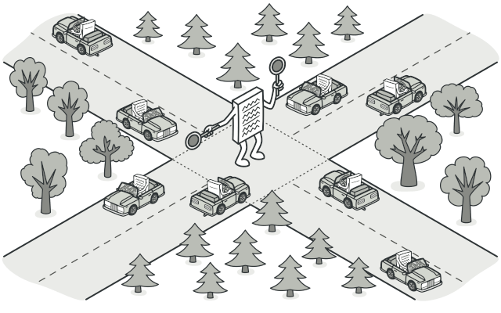
Mediator
@https://refactoring.guru

Slide 39
Mediator
Type: Behavioral Pattern
Intent: Define an object that encapsulated how a set of objects interact. Mediator promotes loose coupling by keeping objects from referring to each other explicitly, and it lets you vary their interaction independently.

Slide 40
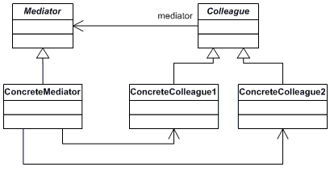
Mediator

Slide 41
Mediator
Applications
Traffic Lights
Communication between Components

Slide 42
Mediator
Pros
Single Responsibility Principle.
You can extract the communications between various components into a single place, making it easier to comprehend and maintain.
Open/Closed Principle.
You can introduce new mediators without having to change the actual components.
You can reduce coupling between various components of a program.
You can reuse individual components more easily.
Cons
Over time a mediator can evolve into a God Object.

Slide 43
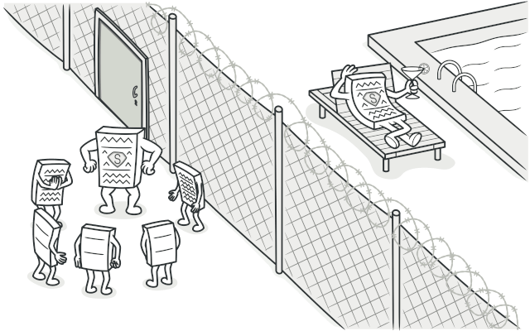
Proxy
@https://refactoring.guru

Slide 44
Proxy
Type: Structural Pattern
Intent: Provide a surrogate or placeholder for another object to control access to it.

Slide 45
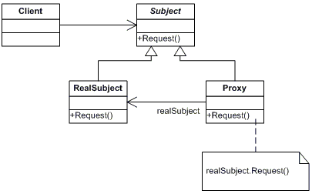
Proxy

Slide 46
Proxy
Applications
Remote Proxy like generated classes in WCF or Swagger Codegen
Lazy Loading (virtual proxies)
Protection

Slide 47
Proxy
Pros
You can control the service object without clients knowing about it.
You can manage the lifecycle of the service object when clients don’t care about it.
The proxy works even if the service object isn’t ready or is not available.
Open/Closed Principle.
You can introduce new proxies without changing the service or clients.
Cons
The code may become more complicated since you need to introduce a lot of new classes.
The response from the service might get delayed.

Slide 48
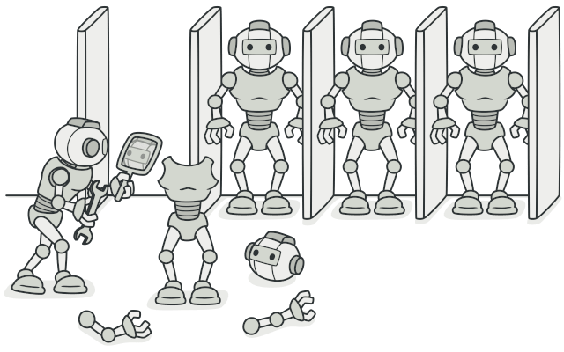
Prototype
@https://refactoring.guru

Slide 49
Prototype
Type: Creational Pattern
Intent: Specify the kinds of objects to create using a prototypically instance and create new objects by copying this prototype.

Slide 50
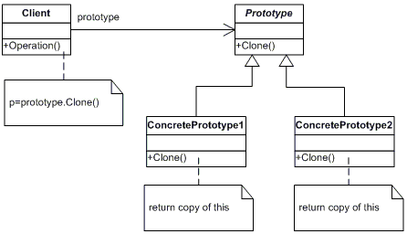
Prototype

Slide 51
Prototype
Applications
ICloneable interface

Slide 52
Prototype
Pros
You can clone objects without coupling to their concrete classes.
You can get rid of repeated initialization code in favor of cloning pre-built prototypes.
You can produce complex objects more conveniently.
You get an alternative to inheritance when dealing with configuration presets for complex objects.
Cons
Cloning complex objects that have circular references might be very tricky.

Slide 53
Exercise 2

Slide 54
Block 3
Builder
Abstract Factory
Factory Method
Composite
Exercise 3

Slide 55
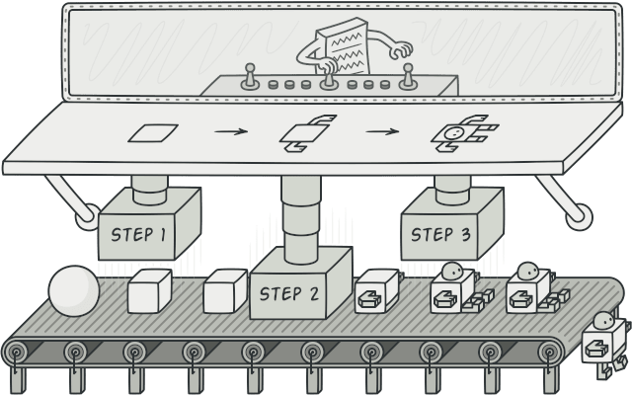
Builder
@https://refactoring.guru

Slide 56
Builder
Type: Creational Pattern
Intent: Separate the construction of a complex object from is representation so that the same construction process can create different representations.

Slide 57
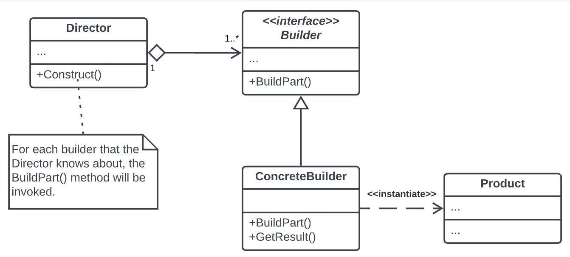
Builder

Slide 58
Builder
Applications
All kind of composite structures
(Database)Connections
Car, Houses
PublicClientApplicationBuilder, ConfidentialClientApplicationBuilder (MSAL)
ConfigBuilder

Slide 59
Builder
Pros
You can construct objects step-by-step, defer construction steps or run steps recursively.
You can reuse the same construction code when building various representations of products.
Single Responsibility Principle.
You can isolate complex construction code from the business logic of the product.
Cons
The overall complexity of the code increases since the pattern requires creating multiple new classes.

Slide 60
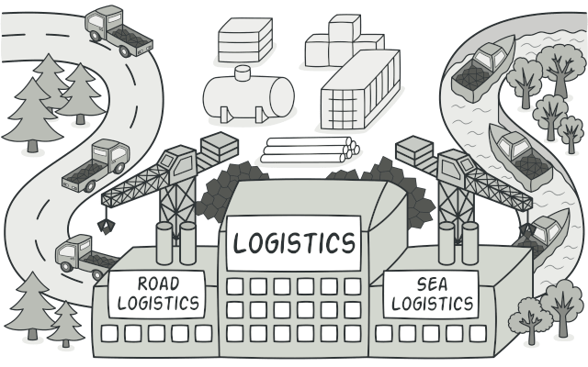
Factory Method
@https://refactoring.guru

Slide 61
Factory Method
Type: Creational Pattern
Intent: The Factory defines an interface for creating a single object, but let subclasses decide which class to instantiate.

Slide 62
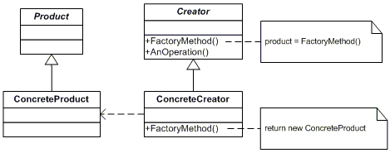
Factory Method

Slide 63
Factory Method
Applications
Transport Factory
Shape Factory
UI elements Factory

Slide 64
Factory Method
Pros
Separates creation logic from client code, improving flexibility.
New types can be added easily.
Simplifies unit testing by allowing mock product creation.
Centralizes object creation logic across the application.
Hides concrete classes from clients, reducing dependency.

Slide 65
Factory Method
Cons
Adds more classes and interfaces, which can complicate maintenance.
Clients need knowledge of specific subclasses.
May lead to unnecessary complexity if applied too broadly.
Factory logic can be harder to test.

Slide 66
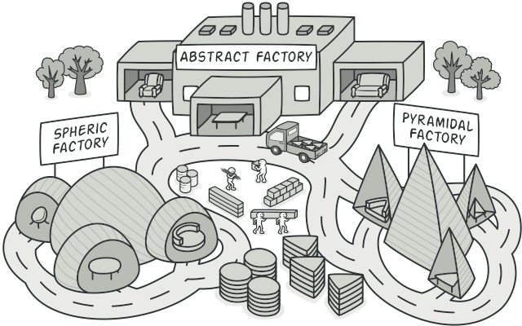
Abstract Factory
@https://refactoring.guru

Slide 67
Abstract Factory
Type: Creational Pattern
Intent: Provide an interface for creating families of related or dependent objects without specifying their concrete classes.

Slide 68
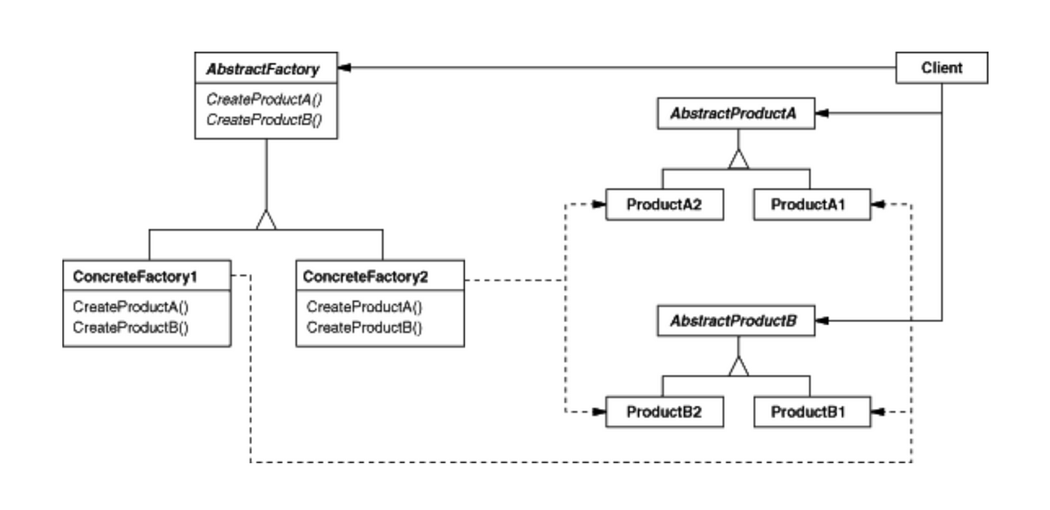
Abstract Factory

Slide 69
Abstract Factory
Applications
Car Models
UI elements Factory
Furniture

Slide 70
Abstract Factory
Pros
You can be sure that the objects you’re getting from a factory are compatible with each other.
You avoid tight coupling between concrete objects and client code.
Single Responsibility Principle.
You can extract the object creation code into one place, making the code easier to support.
Open/Closed Principle.
You can introduce new variants of objects without breaking existing client code.
Cons
The code may become more complicated than it should be, since a lot of new interfaces and classes are introduced along with the pattern.

Slide 71
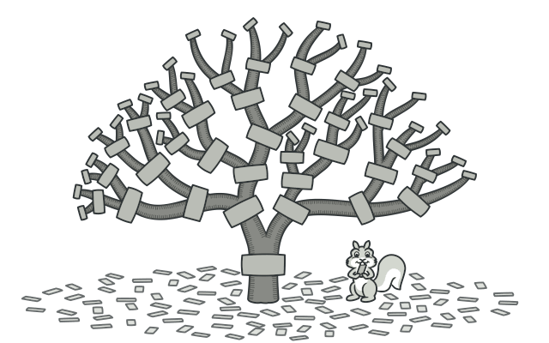
Composite
@https://refactoring.guru

Slide 72
Composite
Type: Structural Pattern
Intent: Compose objects into tree structures to represent part-whole hierarchies. Composite lets clients treat individual objects and composition of objects uniformly.

Slide 73
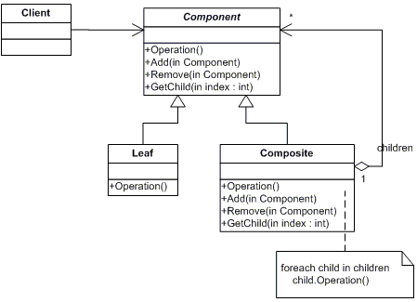
Composite

Slide 74
Composite
Applications
UI –elements (Control class in GDI+)
Bill of Materials
Order systems

Slide 75
Composite
Pros
You can work with complex tree structures more conveniently: use polymorphism and recursion to your advantage.
Open/Closed Principle.
You can introduce new element types into the app without breaking the existing code, which now works with the object tree.
Cons
It might be difficult to provide a common interface for classes whose functionality differs too much.

Slide 76
Exercise 3

Slide 77
Block 4
Bridge
Decorator
Adapter
Exercise 4
Exercise 5

Slide 78
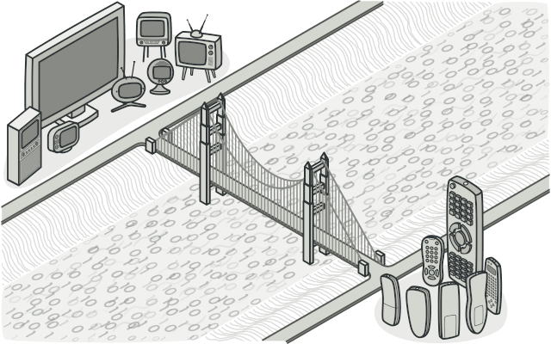
Bridge
@https://refactoring.guru

Slide 79
Bridge
Type: Structural Pattern
Intent: Decouple an abstraction from its implementation so that the two can vary independently.

Slide 80
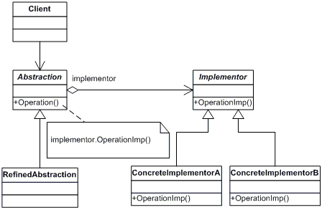
Bridge

Slide 81
Bridge
Applications
Streams and StreamReaders/Writers.
Renting types and Renting objects (boats, houses)
UI Elements and Window Types (Windows, Motif, XWindow)
Devices and Remote Controls

Slide 82
Bridge
Pros
You can create platform-independent classes and apps.
The client code works with high-level abstractions. It isn’t exposed to the platform details.
Open/Closed Principle.
You can introduce new abstractions and implementations independently from each other.
Single Responsibility Principle.
You can focus on high-level logic in the abstraction and on platform details in the implementation.
Cons
Might be more complicated

Slide 83
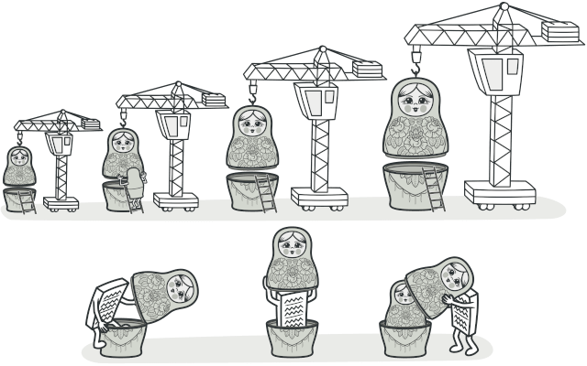
Decorator
@https://refactoring.guru

Slide 84
Decorator
Type: Structural Pattern
Intent: Attach additional responsibilities to an object dynamically. Decorators provide a flexible alternative to subclassing for extending functionality.

Slide 85
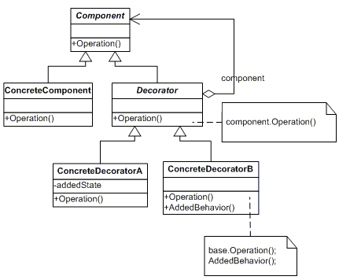
Decorator

Slide 86
Decorator
Applications
Stream (GZipStream, CryptoStream)
Beverages (Milk, Sugar, etc)
Pipeline structures (Pipeline elements add something to what streams through the pipeline)

Slide 87
Decorator
Pros
You can extend an object’s behavior without making a new subclass.
You can add or remove responsibilities from an object at runtime.
You can combine several behaviors by wrapping an object into multiple decorators.
Single Responsibility Principle.
You can divide a monolithic class that implements many possible variants of behavior into several smaller classes.
Cons
It’s hard to remove a specific wrapper from the wrappers stack.
It’s hard to implement a decorator in such a way that its behavior doesn’t depend on the order in the decorator's stack.
The initial configuration code of layers might look ugly.

Slide 88
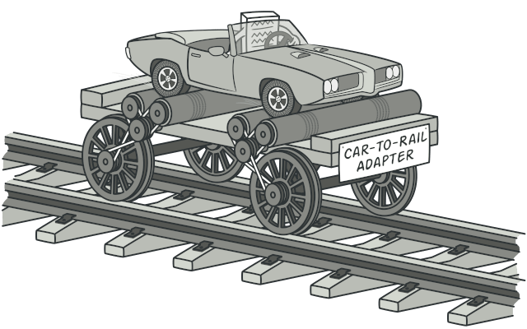
Adapter
@https://refactoring.guru

Slide 89
Adapter
Type: Structural Pattern
Intent: Convert the interface of a class into another interface client expects. Adapter lets classes work together that couldn’t otherwise because of incompatible interfaces

Slide 90
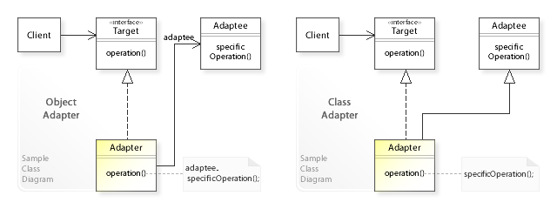
Adapter

Slide 91
Adapter
Applications
Use the Adapter class when you want to use some existing class, but its interface isn’t compatible with the rest of your code.
Use the pattern when you want to reuse several existing subclasses that lack some common functionality that can’t be added to the superclass.

Slide 92
Adapter
Pros
Single Responsibility Principle.
You can separate the interface or data conversion code from the primary business logic of the program.
Open/Closed Principle.
You can introduce new types of adapters into the program without breaking the existing client code, as long as they work with the adapters through the client interface.
Cons
The overall complexity of the code increases because you need to introduce a set of new interfaces and classes.

Slide 93
Exercise 4 & 5

Slide 94
Block 5
Strategy
Façade
Template Method
Flyweight
Exercise 6
Exercise 7

Slide 95

Strategy
@https://refactoring.guru

Slide 96
Strategy
Type: Behavioral Pattern
Intent: Define a family of algorithms, encapsulate each one, and make them interchangeable. Strategy lets the algorithm vary independently from clients that use it.

Slide 97
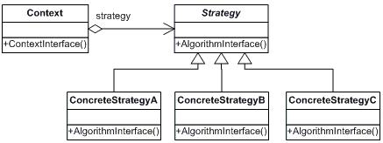
Strategy

Slide 98
Strategy
Applications
Sorting (IComparer)
Filtering (Where)
Route

Slide 99
Strategy
Pros
You can swap algorithms used inside an object at runtime.
You can isolate the implementation details of an algorithm from the code that uses it.
You can replace inheritance with composition.
Open/Closed Principle.
You can introduce new strategies without having to change the context.

Slide 100
Strategy
Cons
If you only have a couple of algorithms and they rarely change, there’s no real reason to overcomplicate the program with new classes and interfaces that come along with the pattern.
Clients must be aware of the differences between strategies to be able to select a proper one.

Slide 101
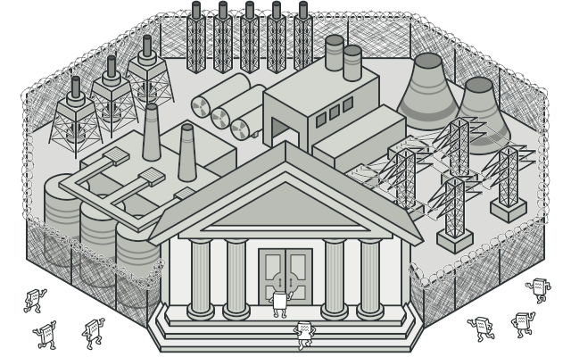
Facade
@https://refactoring.guru

Slide 102
Facade
Type: Structural Pattern
Intent: Provide a unified interface to a set of interfaces in a subsystem. Façade defines a higher-level interface that makes the subsystem easier to use.

Slide 103
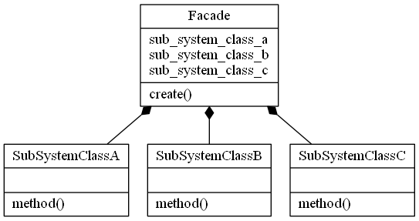
Facade

Slide 104
Facade
Applications
Use the Facade pattern when you need to have a limited but straightforward interface to a complex subsystem.
Use the Facade when you want to structure a subsystem into layers.
API Management in Azure.
Phasing out old functionality.

Slide 105
Facade
Pros
You can isolate your code from the complexity of a subsystem.
Cons
A facade can become a god object coupled to all classes of an app.

Slide 106
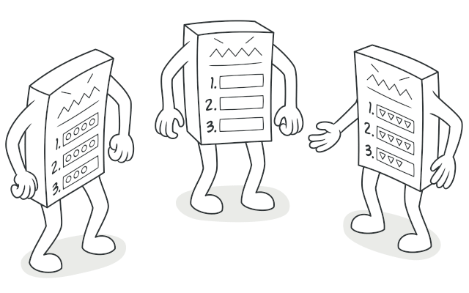
Template Method
@https://refactoring.guru

Slide 107
Template Method
Type: Behavioral Pattern
Intent: Define the skeleton of an algorithm in an operation, deferring some steps to subclasses. Template Method lets subclasses redefine certain steps of an algorithm without changing the algorithm’s structure.

Slide 108
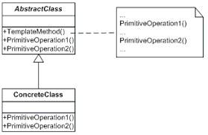
Template Method

Slide 109
Template Method
Applications
Form classes with OnLoad, OnInit, OnDestroy etc.
Data Mining (Defer interpretation of the data. XML, CSV etc)

Slide 110
Template Method
Pros
You can let clients override only certain parts of a large algorithm, making them less affected by changes that happen to other parts of the algorithm.
You can pull the duplicate code into a superclass.
Cons
Some clients may be limited by the provided skeleton of an algorithm.
You might violate the Liskov Substitution Principle by suppressing a default step implementation via a subclass.
Template methods tend to be harder to maintain the more steps they have.

Slide 111
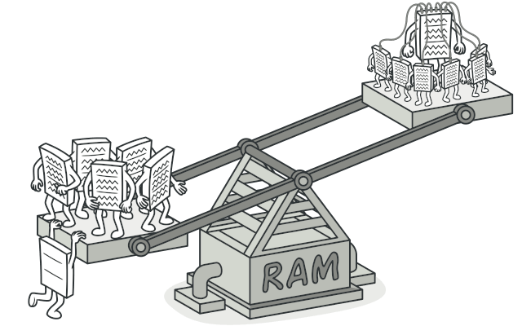
Flyweight
@https://refactoring.guru

Slide 112
Flyweight
Type: Structural Pattern
Intent: Use sharing to support large numbers of fine-grained objects efficiently.

Slide 113
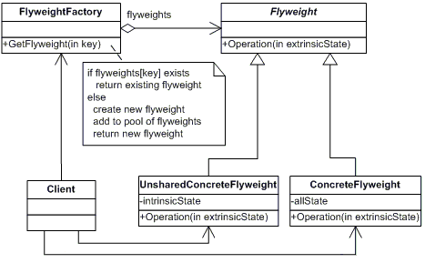
Flyweight

Slide 114
Flyweight
Applications
Use the Flyweight pattern only when your program must support a huge number of objects which barely fit into available RAM.
Graphical Text Processing (characters)
Games (surrounding elements)
Caching
Any reusing system where references doesn’t matter (atomic object does not change)

Slide 115
Flyweight
Pros
You can save lots of RAM, assuming your program has tons of similar objects.
Cons
You might be trading RAM over CPU cycles when some of the context data needs to be recalculated each time somebody calls a flyweight method.
The code becomes much more complicated. New team members will always be wondering why the state of an entity was separated in such a way.

Slide 116
Exercise 6 & 7

Slide 117
Block 6
State
Command
Memento
Exercise 8

Slide 118
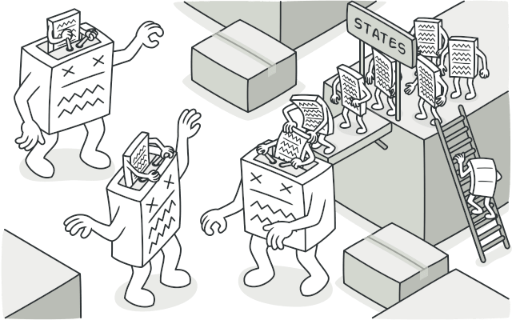
State
@https://refactoring.guru

Slide 119
State
Type: Behavioral Pattern
Intent: Allow an object to alter its behavior when its internal state changes. The object will appear to change its class.

Slide 120
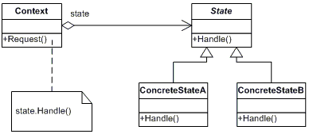
State

Slide 121
State
Applications
Documents (Create, Review, Publish states)
Video, Audio
async
Messaging Apps (Idle, Busy, Away)
OS (Starting, Running, Terminating)

Slide 122
State
Pros
Single Responsibility Principle.
Organize the code related to particular states into separate classes.
Open/Closed Principle.
Introduce new states without changing existing state classes or the context.
Simplify the code of the context by eliminating bulky state machine conditionals.
Cons
Applying the pattern can be overkill if a state machine has only a few states or rarely changes.

Slide 123
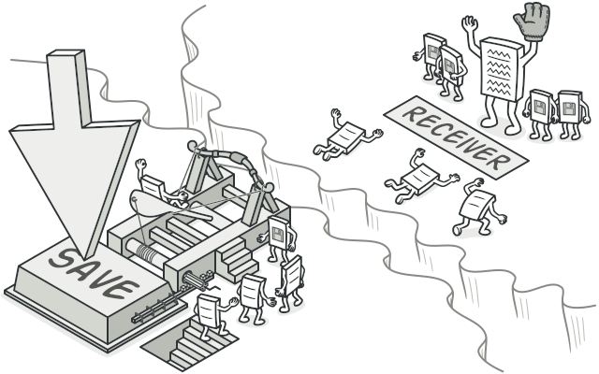
Command
@https://refactoring.guru

Slide 124
Command
Type: Behavioral Pattern
Intent: Encapsulate a request as an object, thereby letting you parameterize clients with different requests, queue or log requests, and support undoable operations.

Slide 125
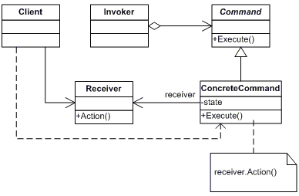
Command

Slide 126
Command
Applications
UI Commands (Save, Undo etc)
WPF (ICommand)

Slide 127
Command
Pros
Single Responsibility Principle.
You can decouple classes that invoke operations from classes that perform these operations.
Open/Closed Principle.
You can introduce new commands into the app without breaking existing client code.
You can implement deferred execution of operations.
You can assemble a set of simple commands into a complex one.
Cons
The code may become more complicated since you’re introducing a whole new layer between senders and receivers.

Slide 128
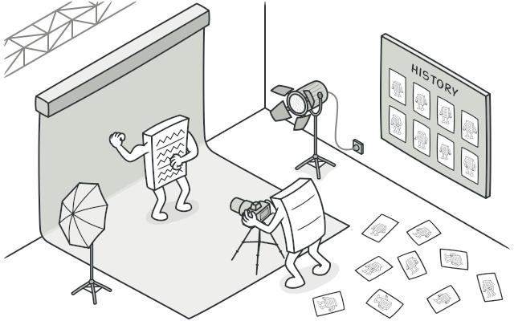
Memento
@https://refactoring.guru

Slide 129
Memento
Type: Behavioral Pattern
Intent: Without violating encapsulation, capture and externalize an object’s internal state so that the object can be restored to this state later.

Slide 130
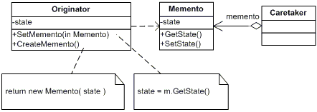
Memento

Slide 131
Memento
Applications
Shapshots of objects (parts)
Undo, Redo scenarios

Slide 132
Memento
Pros
You can produce snapshots of the object’s state without violating its encapsulation.
You can simplify the originator’s code by letting the caretaker maintain the history of the originator’s state.
Cons
The app might consume lots of RAM if clients create mementos too often.
Caretakers should track the originator’s lifecycle to be able to destroy obsolete mementos.

